Slide 1
Secure Data Hiding In Images Using Steganography
CAPSTONE PROJECT
Presented By : Raghavendra.Tati
Student Name : Raghavendra.Tati
College Name & Department : KITS AKSHAR INSTITUTE OF TECHNOLOGY& Computer Science Engineering

Slide 2
OUTLINE
Problem Statement
Technology used
Wow factor
End users
Result
Conclusion
Git-hub Link
Future scope

Slide 3
Problem Statement
The challenge lies in securely transmitting sensitive information by first encrypting it, then concealing the encrypted data within a seemingly innocuous cover image (steganography).

Slide 4
Technology used
Programming Language: Python
Libraries:
OpenCV for image processing
Tkinter (with ttk) for the GUI
NumPy for efficient array manipulation
Platform: Cross-platform (Windows/Linux)
Tools: Visual Studio Code

Slide 5
Wow factors
The fundamental concept of steganography itself: the ability to hide a message in plain sight.
The project successfully hides the message without visibly altering the image at least not in a way easily perceptible to the human eye.
. Seeing the code actually work, with the message being encrypted and decrypted correctly, provides a tangible demonstration of the concept.
This project can be a gateway to understanding more complex concepts. It can spark curiosity about cryptography and information security.

Slide 6
End users
Security professionals and cybersecurity enthusiasts.
Journalists, activists, and government agencies needing secure communication channels.
Students and researchers interested in data privacy and steganography.
General users looking for enhanced digital security.

Slide 7
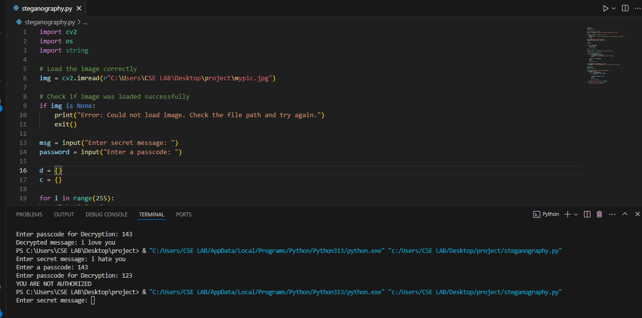
Results

Slide 8
Conclusion
This project successfully implements a basic image steganography technique using Python and the OpenCV library.
It demonstrates the ability to hide a text message within an image and retrieve it using a password-protected decryption process.

Slide 9
GitHub Link
https://github.com/tati-Raghavendra/steganography.git

Slide 10
Future scope(optional)
Support for multiple image formats and higher resolution images.
Extend the approach to video steganography for dynamic data hiding.
Incorporate advanced encryption algorithms to further secure the hidden message.
Develop a web-based or mobile application for broader accessibility.
Explore automated detection and extraction tools for steganographic content.

Slide 11
THANK YOU

